Slide 1
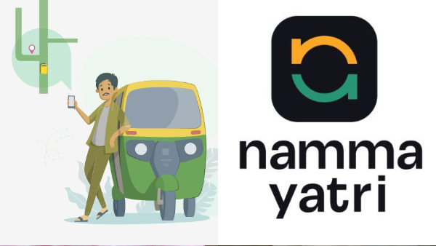

Slide 2
Problem Statement: Drivers come from all ages. It is generally evident that drivers who are not millennials are not very technologically savvy. Despite the advances in technology, the apps and features cannot create value unless they are widely adopted by the drivers. Identify ways to digitally enable drivers, so that they can earn on par with fellow drivers.
Driver's resistance to change
Language barriers
Unviable business models
Unengaging content/training
Lack of accountability and monitoring

Slide 3
SOLUTION:
According to the issue statement, drivers who do not belong to the millennial generation could not be as tech adept and hence would not be able to fully utilize the applications and services that are accessible to them,
Perhaps leading to reduced profits, It is essential to create a thorough plan that considers the requirements and preferences of the drivers in order to handle these issues. This entails giving them individualized
Training, linguistic assistance, and user-friendly tools that are pertinent to their requirements and simple to use.

Slide 4
User-Friendly Apps
Create user-friendly apps that are easy to use, with intuitive interfaces and clear instructions. The apps should be designed to cater to the needs of all drivers, including those who are not technologically savvy.
To make sure that drivers can use the app efficiently to fulfill their jobs, it is crucial to provide user-friendly, simple-to-use apps with intuitive interfaces and detailed instructions. All drivers should be able to use the app efficiently if it is made to accommodate their needs, including those who are not technologically sophisticated.
The design of the app must be carefully studied if it is to be user-friendly. With clearly labelled buttons and icons, the interface should be simple to use and intuitive.

Slide 5
In-App Tutorials
Drivers may effectively learn how to utilize an app and its capabilities by being given in-app training and resources. These tools come in a variety of formats, including video lessons, step-by-step instructions, and FAQs. The ability to watch the app in action and follow along with the instructions makes video lessons an interactive approach for drivers to learn how to use the app.
Concerns and problems that drivers could have can be found under FAQs. functionalities thanks to the in- app lessons and resources that are offered. This results in greater productivity and efficiency as well as a rise in their comfort level and app-using skills. Additionally, it lessens the possibility that users may face problems or make mistakes when utilizing the app, which can eventually enhance their overall satisfaction. Drivers may quickly and simply learn how to utilize the app's features and.

Slide 6
Personalized Support
In order to ensure that all drivers can efficiently utilize an app to perform their jobs, it is essential to provide tailored help to those who may be having trouble utilizing the app. This help can be provided in person at nearby offices or training facilities, over the phone, over chat, or in many other way personalized help with any problems they may run across while utilizing the app. This can be especially helpful for drivers who may not be tech-savvy and may require extra assistance using the app's functions.
Drivers who are new to utilizing applications or who might want more in-depth guidance might benefit particularly from this kind of support. technical assistance may also improve the entire experience. Customized assistance may boost productivity, efficiency, and driver and passenger happiness, resulting in a great user experience for all users.

Slide 7
Training Programs
Due to the efficient connections made possible by mobile apps, the taxi and ride-sharing industries have undergone a transformation. However, if a motorist lacks technological know-how, they can have trouble using these applications. Companies have begun providing training programs to educate drivers fundamental computer and app usage in order to solve this issue.
It is crucial to offer specialized support to all users, including drivers, while creating user-friendly software.
It is critical to make sure that all drivers feel at ease using smartphone apps as they proliferate in the transportation sector. Businesses must be aware that drivers may have varied degrees of technology expertise, and as a result, they must provide a range of support alternatives to help them.
In the end, providing training programs is crucial for developing a successful and usable platform that satisfies the requirements of all users.

Slide 8
Gamification Techniques and Feedback Mechanisms
Gamification strategies are growing in demand in the transportation sector to motivate drivers to make optimal use of an app and its features. Businesses may employ gamification by rewarding drivers who satisfy particular use criteria or accomplish certain tasks by giving them bonuses or better pay rates. For instance, a business may offer incentives to drivers who successfully complete a set number of rides utilizing a specific app feature.
This can thus have a favorable effect on driver retention rates. The development of a user-friendly software requires feedback methods as ll. The option for users to report any difficulties or issues they have with the app allows developers to find and fix any issues as soon as they arise. Businesses can include in-app feedback forms so that users can report problems or recommend changes.
Driver issues can be addressed and specialized help can be given by a professional support team.

Slide 9
CONCLUSIONS
Need for Digital Adoption:
Digital technology is essential for ensuring drivers are paid fairly, comparable to peers in other sectors.
Challenges in Adoption:
Resistance to change from drivers
Language barriers
Ineffective business models
Boring or irrelevant training content
Lack of accountability and monitoring systems
Solutions for Successful Implementation:
Successful digital integration will enhance driver earnings and service quality
Offer personalized assistance
Conduct training programs for digital literacy
Use gamification to increase engagement
Include feedback channels for continuous improvement

Slide 10
Ongoing Nature of Digital Transformation:
Adoption is not a one-time effort—it requires continuous improvement
The sector must remain flexible and open to change
Businesses should prepare for future challenges as technology evolves
Final Outlook:
Successful digital integration will enhance driver earnings and service quality
Adaptability and innovation are key to staying competitive in the digital age

